Slide 1

TEXT ANALYTICS ON INVESTMENT RESEARCH REPORTS
GROUP 5
Kevin Moe
Desmond Ho
Ong Hui lin
Catherine LEO
SIDdhant agrawal
Lim hui ting

Slide 2
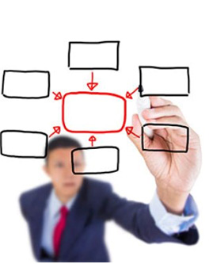




scope
Business
Problem
Analysis &
Discussion
Visualization
Demo
Solutioning
Business Problem
Solutioning
Analysis
Visualization
Demonstration

Slide 3
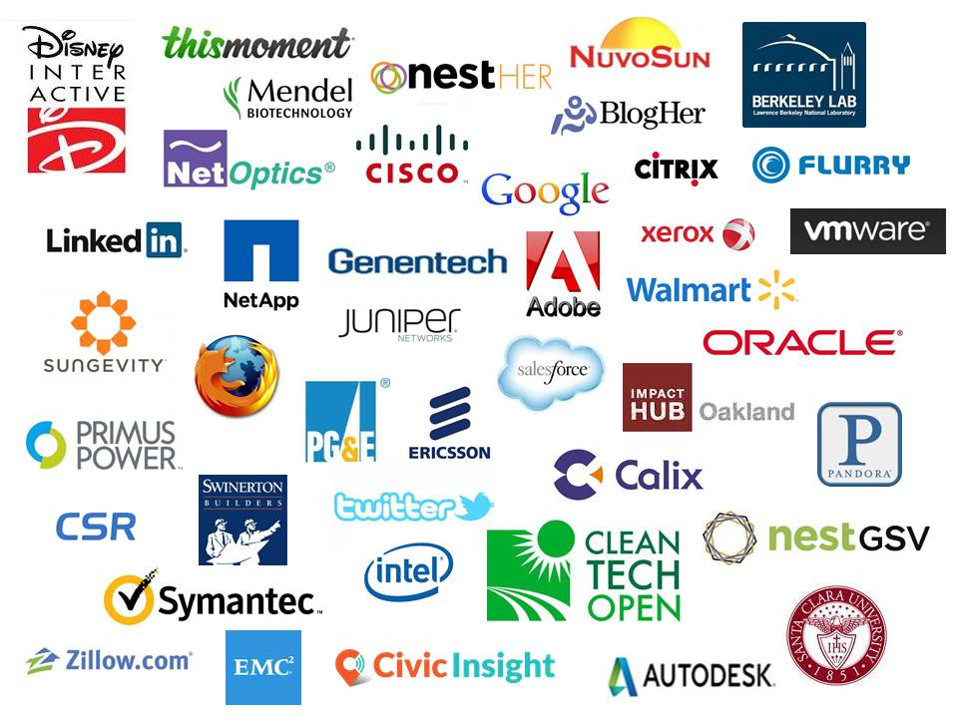
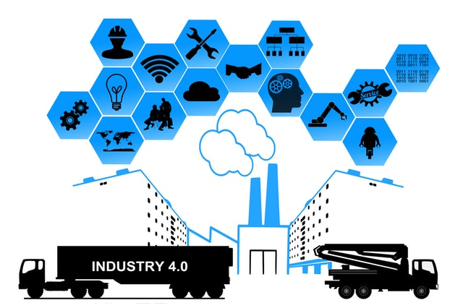
BUSINESS PROBLEM
Investment teams in banks make use of multiple sources of information to make investment recommendations.
Equities:
Which Sector?
Which Company?

Slide 4

BUSINESS PROBLEM
One such source: Investment Research Reports
Research entities provide reports on a subscription basis
Emails
High volume (~1000s/day)
Manual sorting of research reports is tedious, and reading every report is not an efficient use of time.

Slide 5
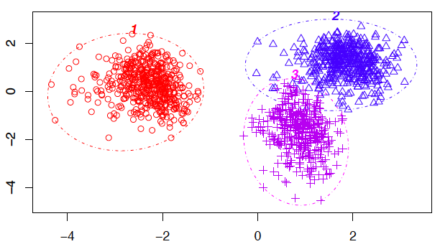
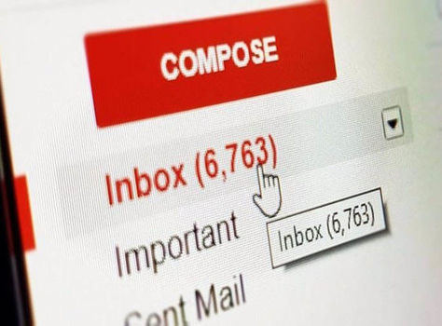


SOLUTIONING
2
1
4
Cluster by industry sector
3
Extract text data from reports*
Using NER to
extract company
names
Determine sentiment of report
*Simulated using PDF files

Slide 6






SOLUTIONING
Energy
Real Estate
Healthcare
Banking
x 400
Classifying them into 2 sentiment categories (optimistic and
not-optimistic)
Using 400 PDFs to simulate email reports
Clustering them into 4 industry sectors

Slide 7
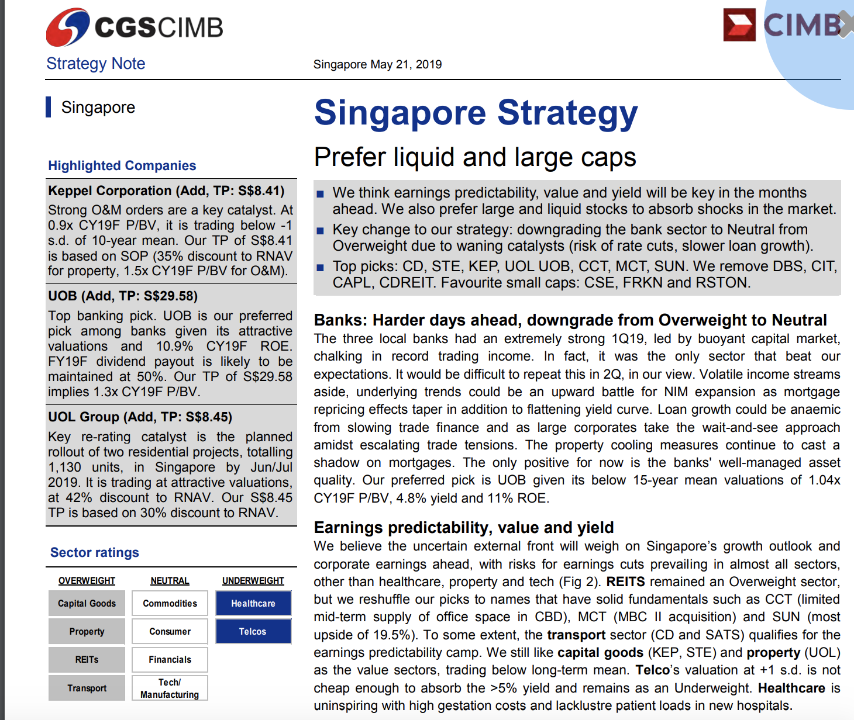
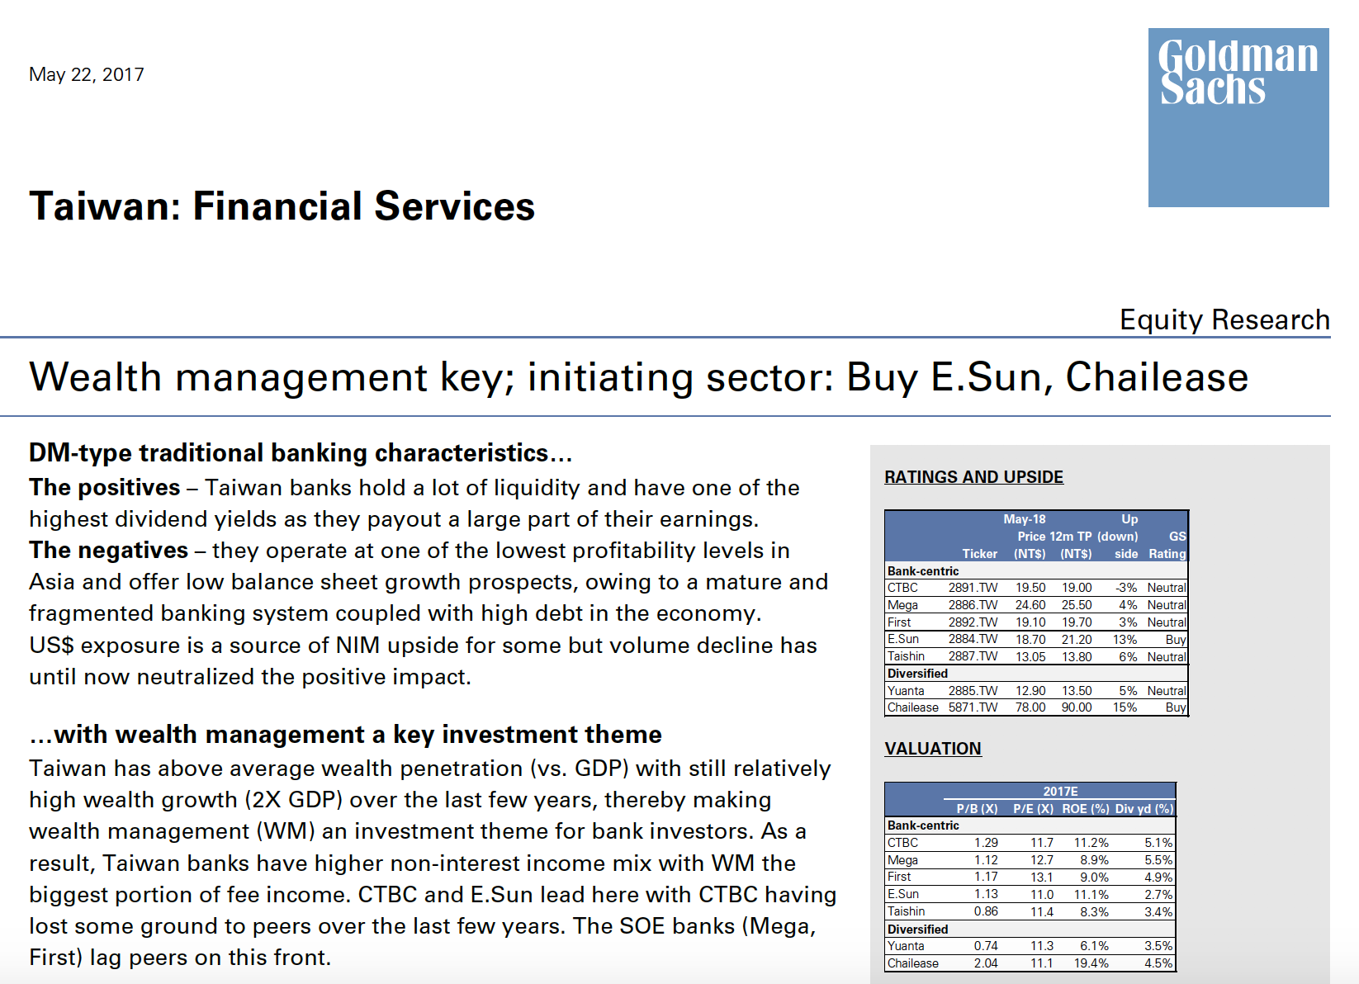
Sample reportS

Slide 8


clustering
3 approaches to clustering were explored
2 unsupervised
1 semi-supervised
Clustering metric: Purity
1
Vectorize the corpus using TF
Filter
2
Extract and preprocess text
Find top k common words
Vectorize using TFIDF, select for max DF
K-means Clustering
Lower()
isAlpha()
Lemmatization()
Stopwords
3
Train word2vec embeddings
Get top N closest words to sector name
Filter + TFIDF
Sector Name

Slide 9
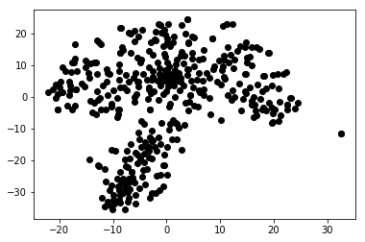
Clustering - tf
Purity vs k
T-SNE Plot
47%
Component 1
Component II
Varied k from 200-600
Consistent purity of ~47%
Used T-SNE to reduce vector dimension from k → 2 for visualization
Visually, only 2 clusters can be observed
Notes:
t-distributed stochastic neighbor embedding (non-linear cousin of PCA)
It is a nonlinear dimensionality reduction technique well-suited for embedding high-dimensional data for visualization in a low-dimensional space of two or three dimensions. Specifically, it models each high-dimensional object by a two- or three-dimensional point in such a way that similar objects are modeled by nearby points and dissimilar objects are modeled by distant points with high probability.

Slide 10
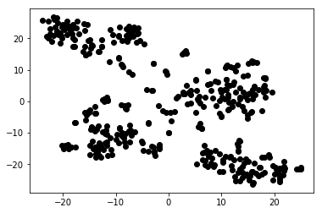
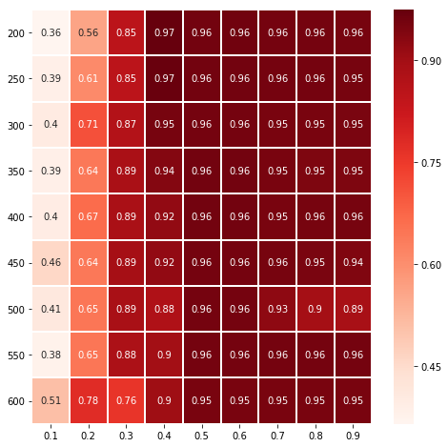
Clustering - tfIDF
maxDF and k
T-SNE Plot
Component 1
97%
K - common words
Component II
k from 200-600; maxDF from 0.1-0.9
Optimum: k-200, maxDF-0.4
Largely independent of k for the ranges explored
Strong dependence on maxDF
maxDF
Notes:
The most common words probably already had a DF that was 0.5, so increasing the maxDF further had no effect.
Significant difference between TF and TFIDF

Slide 11
Clustering – embeddings
w2v Model
Trained embeddings using word2vec
Trained using corpus (skipgram)
Vector Dim = 64
Window = 8
N closest outputs
input
money
Cash
Finance
Bank
Bills
N=8
Real Estate | Banking | Energy | Healthcare
House | Bank | Resource | Hospital
London | Idea | Natural | Medical
Office | Ireland | Production | Health
Vacancy | Liquidity | Crude | Clinic
Residential | Corporate | Holding | Care
Rent | Retail | Exposed | Pharma
Correlation | Hsbc | Conviction | Reimbursement
Property | Finance | Infrastructure | Insurance

Slide 12
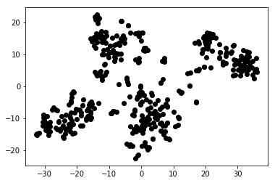
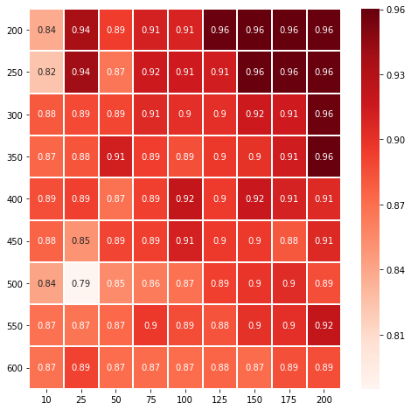
Clustering – embeddings
T-SNE Plot
Component 1
96%
Component II
k from 200-600; N from 10-200
Optimum: k-200*, N: 150-200
Did not go below k=200 to ensure sector names were in the model
Generally performed better than TFIDF over a wider range of parameters
N and k

Slide 13

VISUALIZATION
Both TFIDF and word2vec clustering both gave good purities (96-97%)
Opted to work with the TFIDF clustering model as it was simpler, and had fewer parameters to optimize.
Visualization & Analysis

Slide 14
Sentiment analysis
The team took time to determine the sentiments of the reports
Optimistic
Not optimistic
With the sentiment labels, we
Developed a sentiment lexicon using domain knowledge
Built a supervised classification model (Logistic Regression)
Develop sentiment lexicon
Filter corpus for lexicon words
Vectorize using TFIDF
Logistic Regression Classifier
Metrics, Visualization,
Analysis

Slide 15
Sentiment analysis
Expansion
Efficient
Upside
Bullish
Attractive
Improve
Strong
Appreciate
Sell
Downgrade
Challenges
Critical
Downside
Modest
Underweight
Bearish
Lexicon developed based on common jargon used in the industry to describe the outlook of the security.
Develop sentiment lexicon
Filter corpus for lexicon words
Vectorize using TFIDF
Logistic Regression Classifier
Metrics, Visualization,
Analysis

Slide 16
Sentiment analysis
The dataset had a 70-30 imbalance (more optimistic reports)
Oversampling had to be carried out.
Accuracy, Recall, and Precision.
As we intend to identify companies that are perceived optimistically, it was important to have high precision for the optimistic category.
Develop sentiment lexicon
Filter corpus for lexicon words
Vectorize using TFIDF
Logistic Regression Classifier
Metrics, Visualization,
Analysis

Slide 17
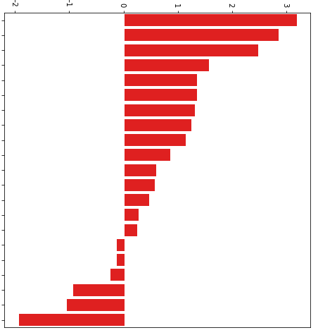
Sentiment analysis
Lexicon Weight
84%
96%
Expansion
Attractive
Strong
Initiate
Catalyst
Leader
Upside
Efficiency
Turnaround
Challenge
Efficient
Appreciate
Improve
Tailwind
Buy
Accuracy: Precision:
Accuracy and precision rate (96%) are reasonable for the intended application.
Low precision for the non-optimistic reports is possibly due to overlaps in the lexicon with the optimistic reports.
Class | Precision (%) | Recall (%) | F1 (%)
Not Opt. | 51 | 84 | 64
Optimistic | 96 | 84 | 90
Modest
Underweight
Critical
Downside
Sell
Downgrade

Slide 18
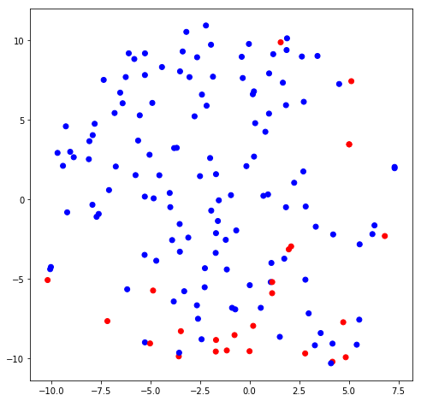
VISUALIZATION
T-SNE Plot
Optimistic
Not Optimistic
Component 1
Component II

Slide 19


Slide 20

CONCLUSION
Demonstrated end-to-end processing, clustering and classification, and information extraction.
Unsupervised
Semi-supervised
Supervised
Learning points:
Clustering of documents can be carried out with reasonable accuracy if the documents contain defining tokens.
Stopword lists are very important.
Classification metric for sentiment analysis had to align with the objectives of the business problem.

Slide 21
FUTURE WORK
Adopt a more supervisory approach to dealing with documents from the banking sector.
More focused selection of stopwords
Extension to use bigrams as keywords
“Bank” vs “Bank Loan”
Sentiment analysis remains challenging in this context because both optimistic and non-optimistic terms tend to appear together in some documents.
Initiate a 3rd category to capture mixed-sentiment documents
Implement a function to flag such documents so that user intervention can be applied

Slide 22
BEYOND THE CLASSROOM
Implementation of word2vec (word embedding) model to provide supervisory input to the clustering.
Provided tableau/T-SNE visualization and analysis for both the results of the tasks, showcasing the next level of insight as to why documents were correctly/wrongly categorized.

Slide 23
Challenge
Sentiment class imbalance: Equity researchers tended to be more ‘optimistic’ – an issue with the raw data. This presented some challenge in training the model accurately.
Data Extracted from PDFs was not clean – many tables and chart captions to deal with, and reports had appendices that were common to all documents. Automatic removal of such noise was a challenge.

Slide 24
CONCLUSION
Demonstrated end-to-end processing, clustering and classification, and information extraction.
Unsupervised
Semi-supervised
Supervised
Clustering Purity
(4 Clusters)
96%
Sentiment
Accuracy
84%
Optimistic
Sentiment
Precision
96%
Demonstrated how this can be deployed in an actual business environment, coupled with the next step of information extraction to determine promising companies in a specific sector.
Notes:
Purity is a measure of the extent to which clusters contain a single class. (fairly balanced)

Slide 25
Work distribution
Kevin Moe
Consolidation and validation of python codes
Python visualisation
Desmond Ho
Python code on sentiment analysis
Tableau visualisation
Lim Hui Ting
Python code on K-means clustering (use of new package scikit)
Ong Hui Lin
Catherine Leo
Siddhant
Text extraction for PDF reports
Python code on OS package
Provided domain knowledge on business problem
Text extraction for PDF reports
Use of domain knowledge to identify keywords for training of sentiment analysis model
Text extraction for PDF reports
Model enhancement with keywords for feature engineering

Slide 26
Thank you!

